Slide 1
XJVA 0400 0 Introduction to Hibernate CRN 73063
Oz Brown
education@ogbrown.com
(866) 220-4777

Slide 2
Meeting Times
Collin College Court Yard Campus Room 322
Four (4) Sessions: 90% = 4 Sessions
Wednesday Dec 10, 2014, 6:30PM – 9:30PM
Friday Dec 12, 2014, 6:30PM – 9:30PM
Wednesday Dec 17, 2014, 6:30PM – 9:30PM
Friday Dec 19, 2014, 6:30PM – 9:30PM

Slide 3
Course Prerequisites
Java Programming II, or equivalent experience
knowledge of SQL
(Structured Query Language)
knowledge of JDBC
(Java DataBase Connectivity)
knowledge of Eclipse
an integrated development environment (IDE)

Slide 4
Course Objectives
Learn how to implement Object-Relational Mapping (ORM) using Hibernate.
Explore the facilities available in Hibernate including retrieval and data persistence.
Use Hibernate with other open source tools (such as Eclipse and MySql).
Implement a Data Access Object (DAO) layer in Hibernate.

Slide 5
Materials
Hibernate Reference Guide 3.6.10
Best Reference for Hibernate
Tutorial should be covered after course…
XML Configurations vs Annotations (most popular)
In Class Materials
Online References

Slide 6
Introductions
Who you are?
Where do you work?
How much Java you use?
Other courses you’ve taken?

Slide 7
Class Background Info
Class: Hibernate Date: 12/10/2014 Time: 6:30 PM – 9:30 PM
Please indicate the technologies you are familiar with and indicate your experience level by circling the appropriate number, e.g. 1 – No knowledge; 5 – Average knowledge; 10 – Expert. This information will help us shape the class to all attendees. All answers are right answers ☺ .
Technology | Experience ( 1 – What’s that?…. 10 – Jedi Knight?)
Windows | <…. 1 …. 2 …. 3 …. 4 …. 5 …. 6 …. 7 …. 8 …. 9 …. 10 …. >
Java Programming | <…. 1 …. 2 …. 3 …. 4 …. 5 …. 6 …. 7 …. 8 …. 9 …. 10 …. >
Java Web Apps | <…. 1 …. 2 …. 3 …. 4 …. 5 …. 6 …. 7 …. 8 …. 9 …. 10 …. >
Java Spring Framework | <…. 1 …. 2 …. 3 …. 4 …. 5 …. 6 …. 7 …. 8 …. 9 …. 10 …. >
JDBC | <…. 1 …. 2 …. 3 …. 4 …. 5 …. 6 …. 7 …. 8 …. 9 …. 10 …. >
MySQL | <…. 1 …. 2 …. 3 …. 4 …. 5 …. 6 …. 7 …. 8 …. 9 …. 10 …. >
Eclipse | <…. 1 …. 2 …. 3 …. 4 …. 5 …. 6 …. 7 …. 8 …. 9 …. 10 …. >
Maven | <…. 1 …. 2 …. 3 …. 4 …. 5 …. 6 …. 7 …. 8 …. 9 …. 10 …. >
Hibernate | <…. 1 …. 2 …. 3 …. 4 …. 5 …. 6 …. 7 …. 8 …. 9 …. 10 …. >
Mac | <…. 1 …. 2 …. 3 …. 4 …. 5 …. 6 …. 7 …. 8 …. 9 …. 10 …. >

Slide 8
Lesson Plan
Session 1:
+Review of SQL
+Review of JDBC
Introduction to ORM and Hibernate
Hibernate Architecture
Major Hibernate Components
Setting Up the Hibernate Environment
Hibernate States

Slide 9
Lesson Plan (continued)
Session 2:
Introduction to ORM Mapping
Independent Objects
Embedded Objects
Relationships between Objects
Objects that are inherited (various approaches)
Hibernate Mapping using XML Configuration
Hibernate Mapping using Annotations

Slide 10
Lesson Plan (continued)
Session 3:
Hibernate Query Languages (HQL and Criteria)
Dealing with more complexity
Object Oriented Querying
CRUD Operations and DAOs
Read
Write
Create
Delete

Slide 11
Lesson Plan (continued)
Session 4:
Cascading, Eager & Lazy Fetching
How do you make sure you don’t end up with orphans in your database
Much easier with Hibernate mappings
How soon do you need all of the data in an object?
Main Object Retrieve first and a proxy for other members
Misc

Slide 12
Quick Exercise A
Verify our work environments:
Using Eclipse on Your Desktop Environment
Write a “Hello World” Java application

Slide 13
Exercise B
Using MySQL
Create a database named “peopledb”
Create a table named “persontbl”
Columns
id BigInt; primary key; auto increment
name varchar(255)
address varchar(255)
phone varchar(20)
Insert rows
Name: “Suzie” Address: “123 Street” Phone: “123-456-7890”
Name:”Bill” Address: “456 Avenue” Phone: “098-865-4321”
List the rows

Slide 14
Problem Statement
Java Associations
Aggregation
Composition
Inclusion
Inheritance
Database Relationships
Primary Keys
Foreign Keys
Columns
?
Hibernate

Slide 15
Persistence
What’s New? Hibernate
Object
Domain Model
Previously
SQL
JDBC
objectName.save(nameOfObjectToSave);

Slide 16
JDBC Architecture
Any Java Application
Domain Model
All collections of related objects
DAO
JDBC
Persistence – DAO Method using SQL and JDBC
Read – DAO Method using SQL and JDBC
Update – DAO Method SQL and JDBC
You have to write all the code to handle a list of objects.
You have to know all the details of the schema and all properties of the object
You convert all the properties into the relational tables
DBMS

Slide 17
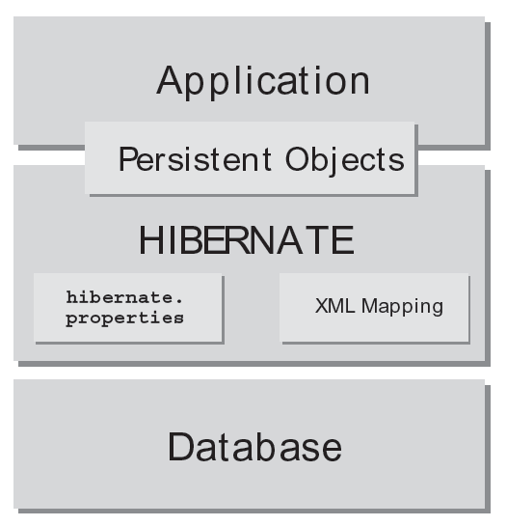
Hibernate Architecture
Domain Model
All collections of related objects
In principle you don’t have to know the Schema
You do have to know all the mappings.
How to map the object to the tables

Slide 18
Setting Up a Hibernate Development Environment (1)
Firefox
https://www.mozilla.org/en-US/firefox/new/
JDK 7 and JRE 7 Installation Guide
http://docs.oracle.com/javase/7/docs/webnotes/install/index.html
Oracle JDK 7 and JRE 7 Certified System Configurations
http://www.oracle.com/technetwork/java/javase/config-417990.html
MySQL 5.6.22
http://dev.mysql.com/doc/refman/5.6/en/installing.html
Eclipse - Indigo
http://www.eclipse.org/indigo/
http://wiki.eclipse.org/The_Official_Eclipse_FAQs
Hibernate 3.6.10
http://sourceforge.net/projects/hibernate/files/hibernate3/
http://sourceforge.net/projects/hibernate/files/hibernate3/3.6.10.Final/hibernate-distribution-3.6.10.Final-dist.zip/download
http://en.wikipedia.org/wiki/Hibernate_(Java)
http://docs.jboss.org/hibernate/core/3.6/javadocs/

Slide 19
Setting Up a Hibernate Development Environment (2)
Latest official SLF4J distribution
http://www.slf4j.org/download.html
mysql-connector-java
http://mvnrepository.com/artifact/mysql/mysql-connector-java/5.1.26
Apache Log4j 1.2
http://mvnrepository.com/artifact/log4j/log4j/1.2.16
Optional: Lightweight 100% Java SQL Database Engine
http://mvnrepository.com/artifact/hsqldb/hsqldb/1.8.0.10
Optional: WinZip Utility
http://www.winzip.com/win/en/index.htm
Optional: StuffIt Utility
http://my.smithmicro.com/stuffit-file-compression-software.html

